Slide 1
CRYSTALLOGRAPHY
Dr. Aarti Sharma

Slide 2
A solid consist of atoms or clusters of atoms arranged in close proximity.
The physical significance of a solids and its properties are closely related to the scheme of arrangement of atoms within the solid.
CRYSTALLOGRAPHY – is the study of crystals.
Its definition is “Crystallography is the experimental science of determining the arrangement of atoms in crystalline solids”

Slide 3
Classification of solids
Solids are classified in three categories
Single crystals
Polycrystalline solids
Amorphous solids

Slide 4
Single crystals – Atoms are arranged in a regular periodic pattern in three dimensions.

Slide 5
Space lattice
A regular and periodic arrangement of atoms is the most important feature of crystals. The actual arrangement of atoms is called the Structure.
Suppose the atoms or clusters of atoms in a crystal are represented by points that corresponds to their mean positions. Then we obtain a regular distribution of points in space. These points are called lattice points or lattice sites.
Lattice point represent atom locations.
The three-dimensional network of regularly arranged points is known as a space lattice.
It is an imaginary geometrical framework.

Slide 6
Space lattice is defined as an array of points in three dimensions in which every point has surroundings identical to that of every other point.
A space lattice can be generated by successive translations of an initial point.
Lattice point satisfies the condition of periodicity.
The space lattice is the skeleton upon which crystal structure is built by placing atoms on or near the lattice points.

Slide 7
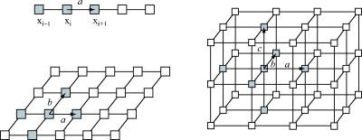
1D, 2D, 3D lattices
To define movement of repeating unit:
2D: two vectors which are non-collinear
3D: three vectors which are non-coplanar
Periodicity:
R = n₁a + n₂b + n₃c

Slide 8
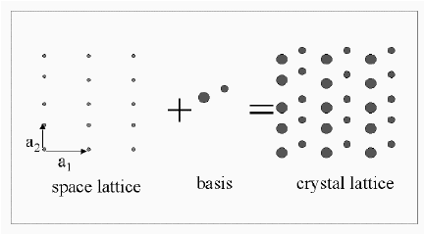
Crystal Structure
The crystal structure is formed only when a group of atoms is identically attached to each lattice point.
The group of atoms that is associated with every lattice point is called a basis.
A crystal structure is thus the result of two quantities:
Lattice + basis/Motif/Atoms → Crystal structure

Slide 9
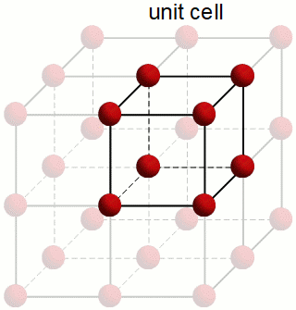
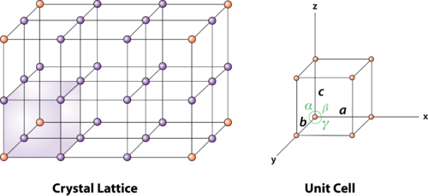
Unit cell
The unit cell is the smallest geometrical unit, which when repeated in space indefinitely, generates the space lattice.

Slide 10
It is the smallest unit that carries a full description of the entire lattice.
Three translational vectors a, b and c lie along the crystallographic axes.
The intercepts a, b and c defines the dimensions of the unit cell and are known as primitives.
The axial lengths (a, b and c) and inter-axial angles are α, β and γ are known as the basic of lattice parameters.
Primitive unit cell- if the volume in space contains only one lattice point or atoms only at the corner of the unit cell.
If there are more two or more lattice points per unit cell, then it is called non-primitive unit cell.
The volume of the unit cell is given as (a × b). c

Slide 11
Bravais lattices
Bravais showed that there are only fourteen different ways of arranging identical points in three-dimensional space, satisfying the condition of periodicity, so that they are in every way equivalent in their surroundings. These fourteen types of arrangements are called the space lattices or bravais lattices. There are seven primitive cells and seven non-primitive cells.
With 14 types of lattices and on the basis of primitive cell, crystals are grouped into 7 systems.
Cubic
Tetragonal
Orthorhombic
Monoclinic
Triclinic
Hexagonal
Rhombohedral (trigonal)

Slide 12
Bravais Lattices | Crystal system | Unit cell axes and angles | Types of bravais lattices
 | Cubic System | α= β= γ = 90º a= b= c | Simple cubic Body Centered Face-Centered
 | Tetragonal system | α= β= γ = 90º a = b ≠ c | Simple tetragonal lattice Body-centered Tetragonal lattices
 | Orthorhombic | α= β= γ = 90º a ≠ b ≠ c | Simple Orthorhombic lattice Base-centered Orthorhombic Body-centered Orthorhombic Face-centered Orthorhombic
 | Monoclinic | α = γ = 90º ≠ β a ≠ b ≠ c | Simple Monoclinic lattice Base-centered Monoclinic
 | Triclinic | α≠ β≠ γ a ≠ b ≠ c | Simple Triclinic lattice
 | Rhombhohedral or trigonal | α = β= γ ≠ 90º < 120º a= b= c | Simple Rhombhohedral or trigonal lattice
 | Hexagonal | α = β = 90º and γ = 120º a = b ≠ c | Simple hexagonal lattice

Slide 13
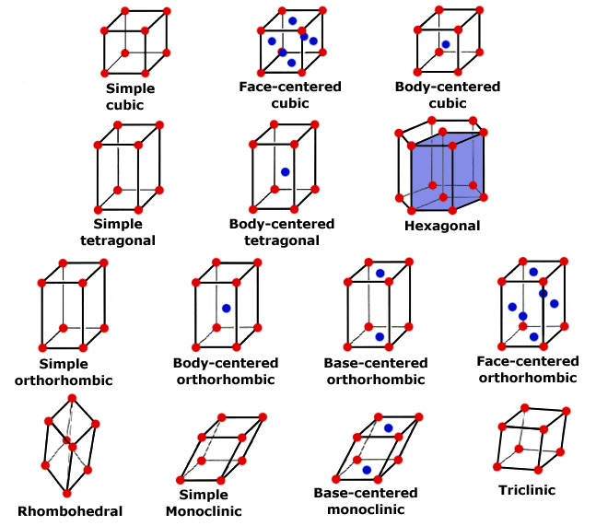

Slide 14
Calculation of Parameters of a cubic Lattice
A unit cell is characterized by a set of characteristics namely,
Volume, effective number of atoms, atomic packing fraction and density.

Slide 15
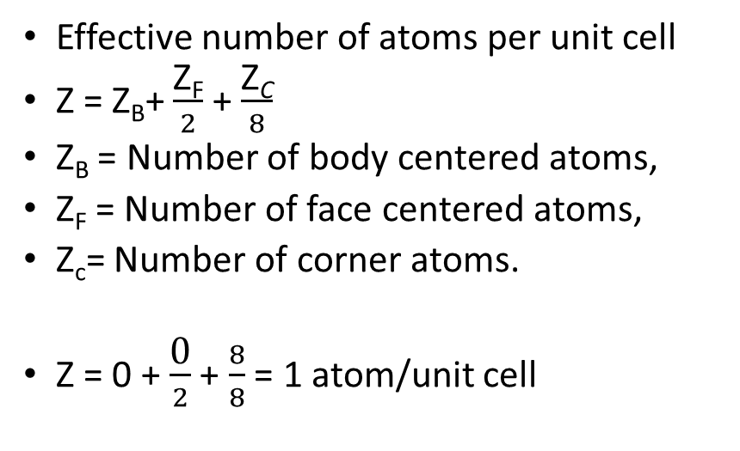
Simple cubic cell (SC)
Effective number of atoms per unit cell
Z = Z_{B}+ $\frac{\text{Z}\text{F}}{2}$ + $\frac{\text{Z}\text{C}}{8}$
Z_{B} = Number of body centered atoms,
Z_{F} = Number of face centered atoms,
Z_{c}= Number of corner atoms.
Z = 0 + $\frac{\text{0}}{2}$ + $\frac{8}{8}$ = 1 atom/unit cell
Unit cell volume:
a = b = c, all the edges are of equal length of a. Therefore, volume is
V= a³
Coordination number, CN:
The coordination number of an atom in a crystal is the number of nearest neighbor atoms. It signifies the tightness of the packing of atoms in the crystal.
The coordination number is 6
Atomic radius, r
In SC cell
Relationship between the apparent size of the atom and the edge of the unit cell.
2r = a ; R = a/2

Slide 16
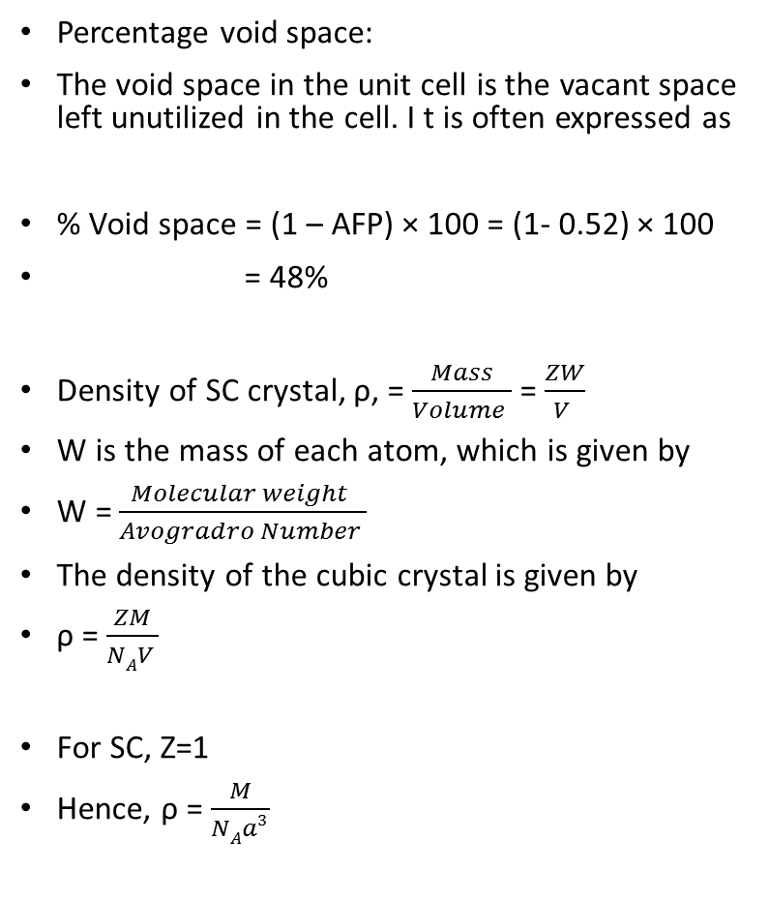
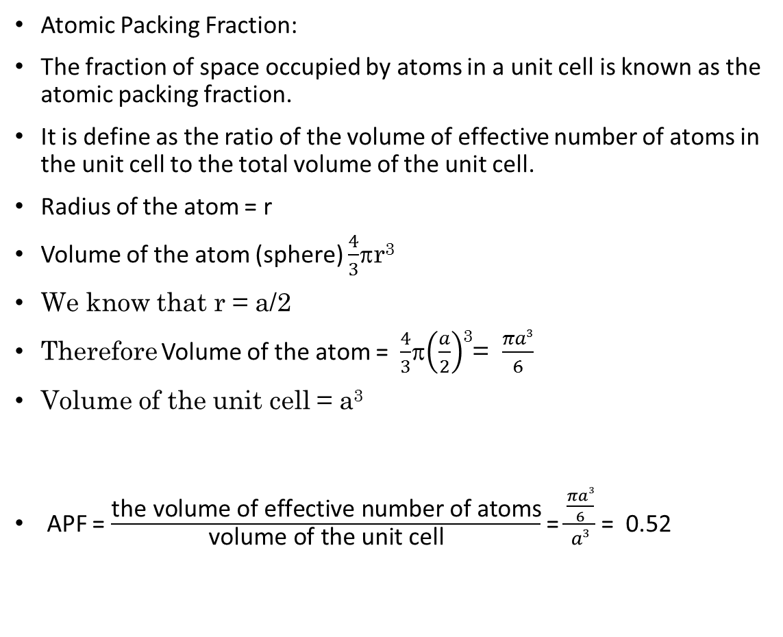
Atomic Packing Fraction:
The fraction of space occupied by atoms in a unit cell is known as the atomic packing fraction.
It is define as the ratio of the volume of effective number of atoms in the unit cell to the total volume of the unit cell.
Radius of the atom = r
Volume of the atom (sphere) $\frac{4}{3}$r³
We know that r = a/2
Therefore Volume of the atom = $\frac{4}{3}$$\left(\frac{a}{2}\right)$³= $\frac{πa3}{6}$
Volume of the unit cell = a³
APF = $\frac{\text{the} \text{volume} \text{of} \text{effective} \text{number} \text{of} \text{atoms}}{\text{volume} \text{of} \text{the} \text{unit} \text{cell}}$ = $\frac{\frac{πa3}{6}}{a3}$ = 0.52
Percentage void space:
The void space in the unit cell is the vacant space left unutilized in the cell. I t is often expressed as
% Void space = (1 – AFP) × 100 = (1- 0.52) × 100
= 48%
Density of SC crystal, ρ, = $\frac{Mass}{Volume }$ = $\frac{ZW}{V }$
W is the mass of each atom, which is given by
W = $\frac{Molecular weight }{Avogradro Number }$
The density of the cubic crystal is given by
ρ = $\frac{ZM}{NAV }$
For SC, Z=1
Hence, ρ = $\frac{M}{NAa3 }$

Slide 17
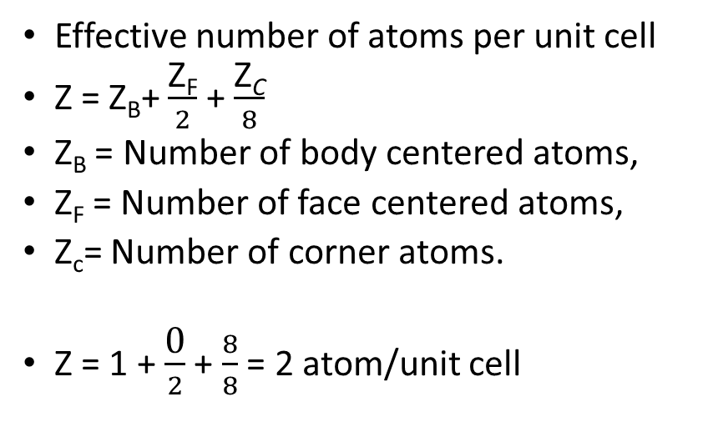
Body centered cubic cell (BCC)
Effective number of atoms per unit cell
Z = Z_{B}+ $\frac{\text{Z}\text{F}}{2}$ + $\frac{\text{Z}\text{C}}{8}$
Z_{B} = Number of body centered atoms,
Z_{F} = Number of face centered atoms,
Z_{c}= Number of corner atoms.
Z = 1 + $\frac{\text{0}}{2}$ + $\frac{8}{8}$ = 2 atom/unit cell
Unit cell volume:
a = b = c, all the edges are of equal length of a. Therefore, volume is
V= a³
Coordination number, CN:
The coordination number is 8
Atomic radius, r
In SC cell
Relationship between the apparent size of the atom and the edge of the unit cell.
2r = a ; r = a/2

Slide 18
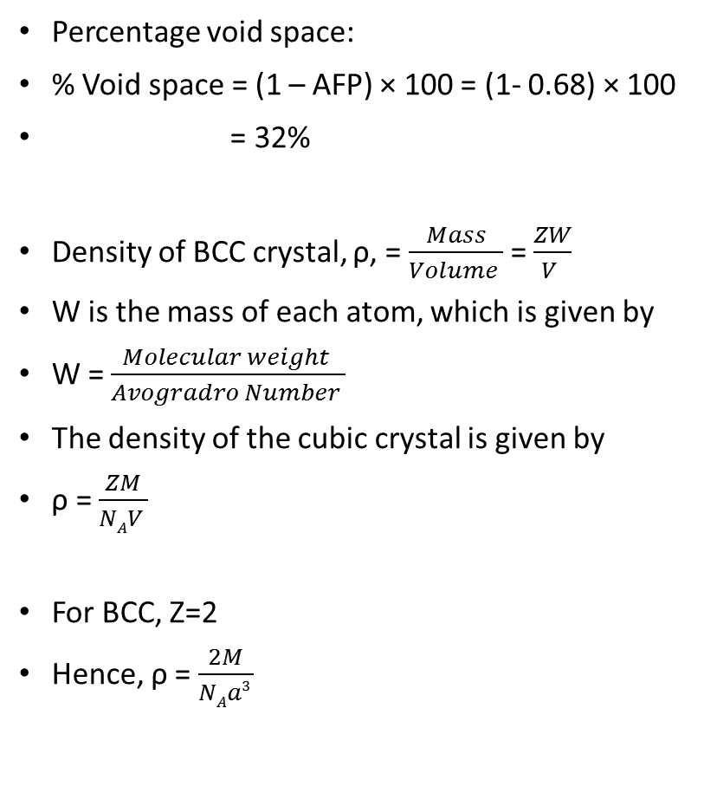
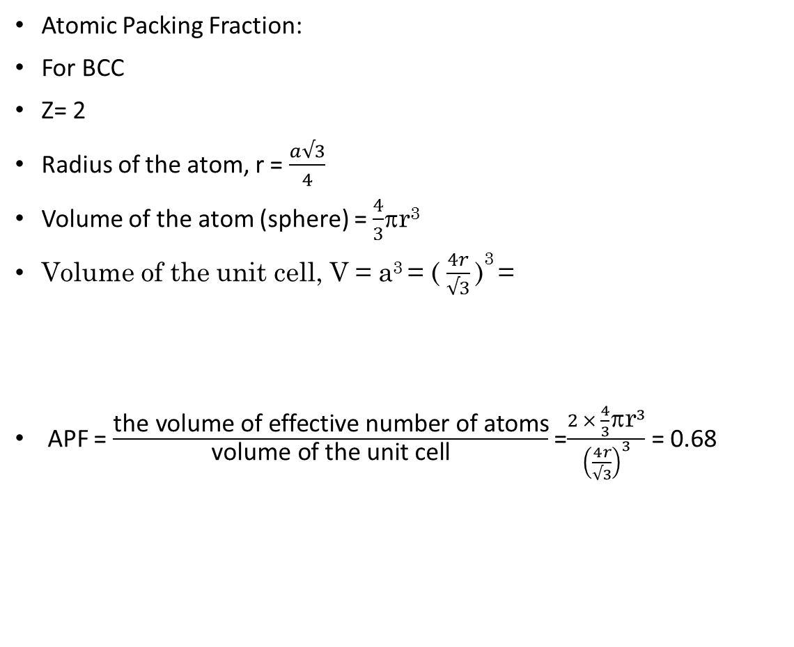
Atomic Packing Fraction:
For BCC
Z= 2
Radius of the atom, r = $\frac{a√3}{4}$
Volume of the atom (sphere) = $\frac{4}{3}$r³
Volume of the unit cell, V = a³ = ( $\frac{4r}{√3}$ )³ =
APF = $\frac{\text{the} \text{volume} \text{of} \text{effective} \text{number} \text{of} \text{atoms}}{\text{volume} \text{of} \text{the} \text{unit} \text{cell}}$ =$\frac{{2 × \frac{4}{3}\text{}\text{r}}^{3}}{{\left(\frac{4r}{√3}\right)}^{3}}$ = 0.68
Percentage void space:
% Void space = (1 – AFP) × 100 = (1- 0.68) × 100
= 32%
Density of BCC crystal, ρ, = $\frac{Mass}{Volume }$ = $\frac{ZW}{V }$
W is the mass of each atom, which is given by
W = $\frac{Molecular weight }{Avogradro Number }$
The density of the cubic crystal is given by
ρ = $\frac{ZM}{NAV }$
For BCC, Z=2
Hence, ρ = $\frac{2M}{NAa3 }$

Slide 19
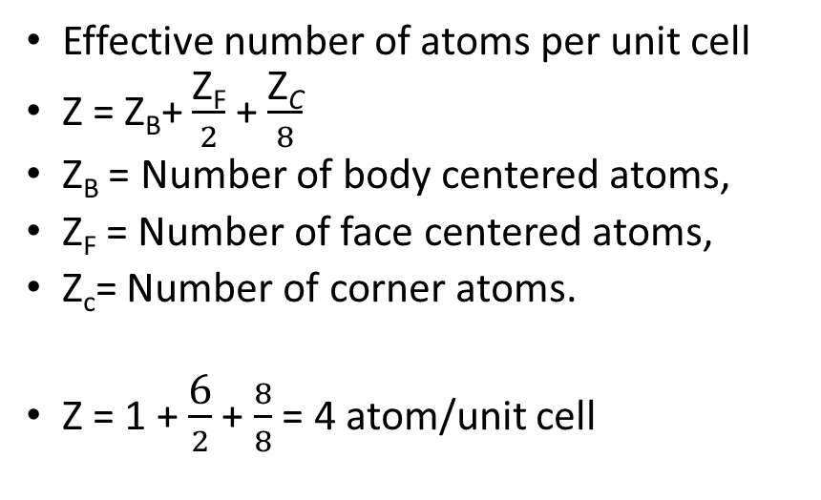
Face centered cubic cell (FCC)
Effective number of atoms per unit cell
Z = Z_{B}+ $\frac{\text{Z}\text{F}}{2}$ + $\frac{\text{Z}\text{C}}{8}$
Z_{B} = Number of body centered atoms,
Z_{F} = Number of face centered atoms,
Z_{c}= Number of corner atoms.
Z = 1 + $\frac{\text{6}}{2}$ + $\frac{8}{8}$ = 4 atom/unit cell
Unit cell volume:
a = b = c, all the edges are of equal length of a. Therefore, volume is
V= a³
Coordination number, CN:
The coordination number is 12
Atomic radius, r
In SC cell
Relationship between the apparent size of the atom and the edge of the unit cell.
2r = a ; r = a/2

Slide 20
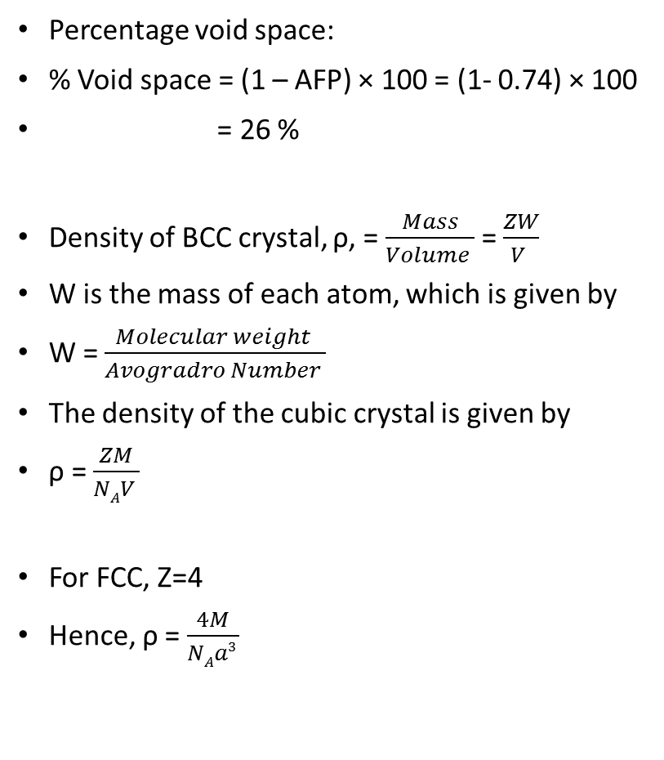
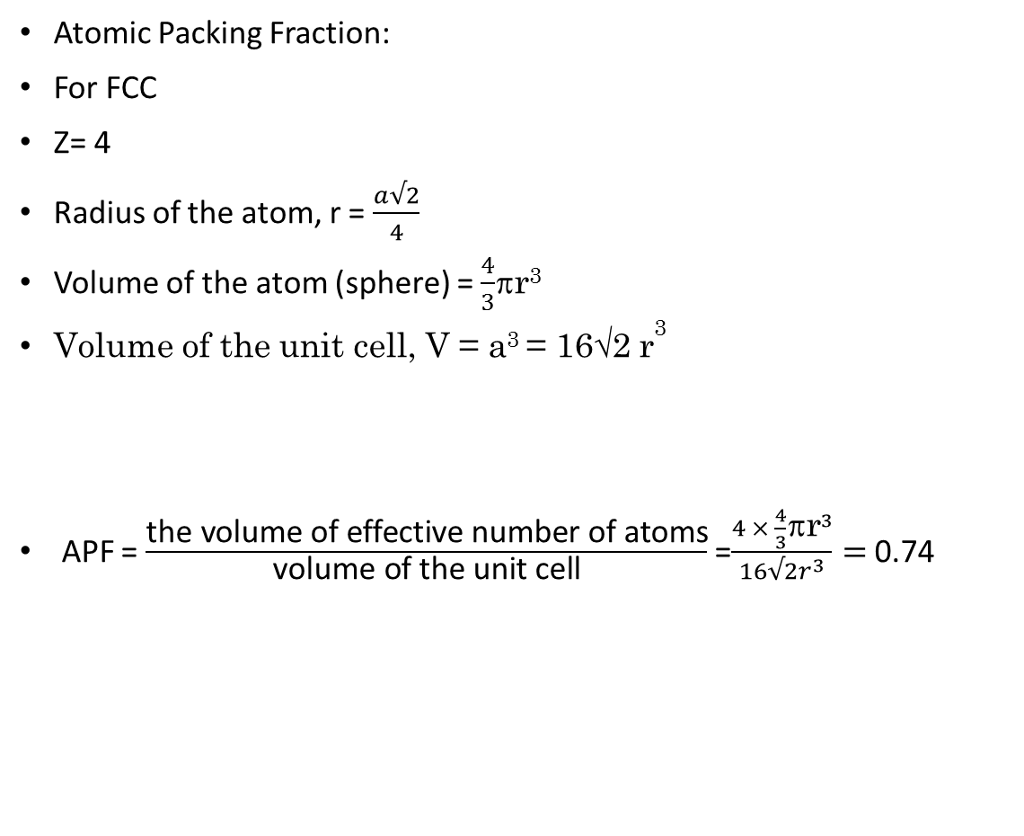
Atomic Packing Fraction:
For FCC
Z= 4
Radius of the atom, r = $\frac{a√2}{4}$
Volume of the atom (sphere) = $\frac{4}{3}$r³
Volume of the unit cell, V = a³ = 16√2 r³
APF = $\frac{\text{the} \text{volume} \text{of} \text{effective} \text{number} \text{of} \text{atoms}}{\text{volume} \text{of} \text{the} \text{unit} \text{cell}}$ =$\frac{{4 × \frac{4}{3}\text{}\text{r}}^{3}}{16√2r^{3}}=$0.74
Percentage void space:
% Void space = (1 – AFP) × 100 = (1- 0.74) × 100
= 26 %
Density of BCC crystal, ρ, = $\frac{Mass}{Volume }$ = $\frac{ZW}{V }$
W is the mass of each atom, which is given by
W = $\frac{Molecular weight }{Avogradro Number }$
The density of the cubic crystal is given by
ρ = $\frac{ZM}{NAV }$
For FCC, Z=4
Hence, ρ = $\frac{4M}{NAa3 }$

Slide 21
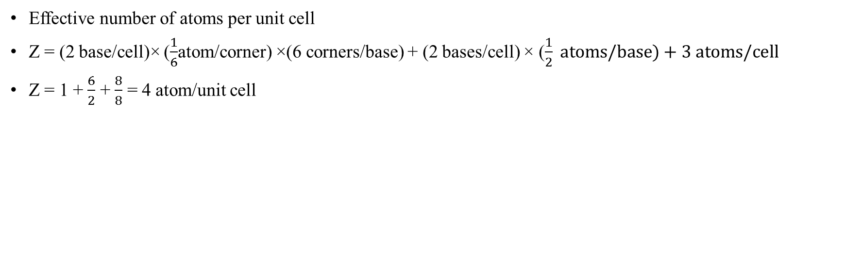
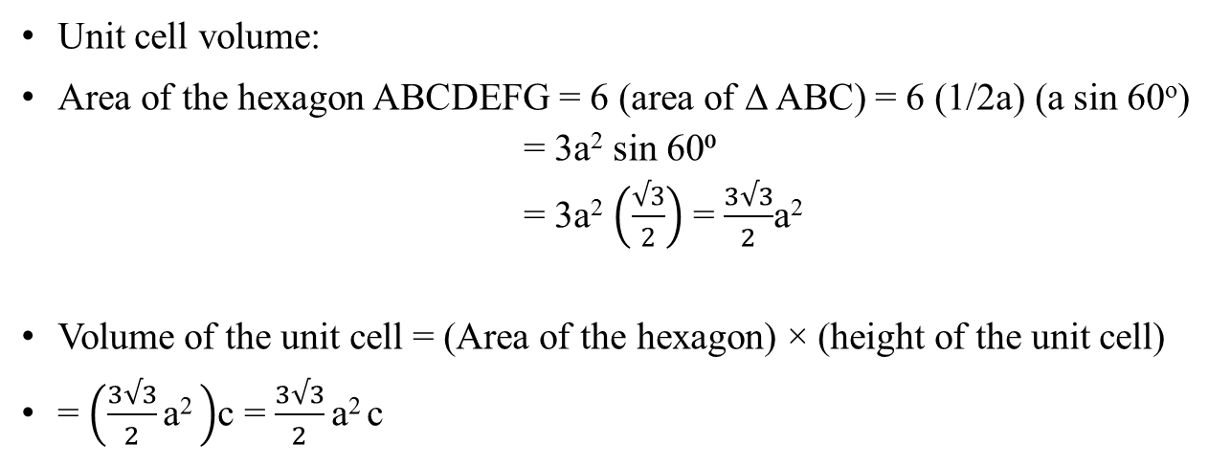
Hexagonal close packed (HCP) Structure
Effective number of atoms per unit cell
Z = (2 base/cell)× ($\frac{1}{6}$atom/corner) ×(6 corners/base) + (2 bases/cell) × ($\frac{1}{2} atoms/base)+3 atoms/cell$
Z = 1 + $\frac{6}{2}$ + $\frac{8}{8}$ = 4 atom/unit cell
Coordination number, CN:
The coordination number is 12
Unit cell volume:
Area of the hexagon ABCDEFG = 6 (area of ∆ ABC) = 6 (1/2a) (a sin 60º)
= 3a² sin 60⁰
= 3a² $\left(\frac{√3}{2}\right)$ = $\frac{3√3}{2}$a²
Volume of the unit cell = (Area of the hexagon) × (height of the unit cell)
= $\left(\frac{3√3}{2}\text{a}\text{2 }\right)$c = $\frac{3√3}{2}\text{a}\text{2 }$c
Atomic radius, r
2r = a ; r = a/2

Slide 22
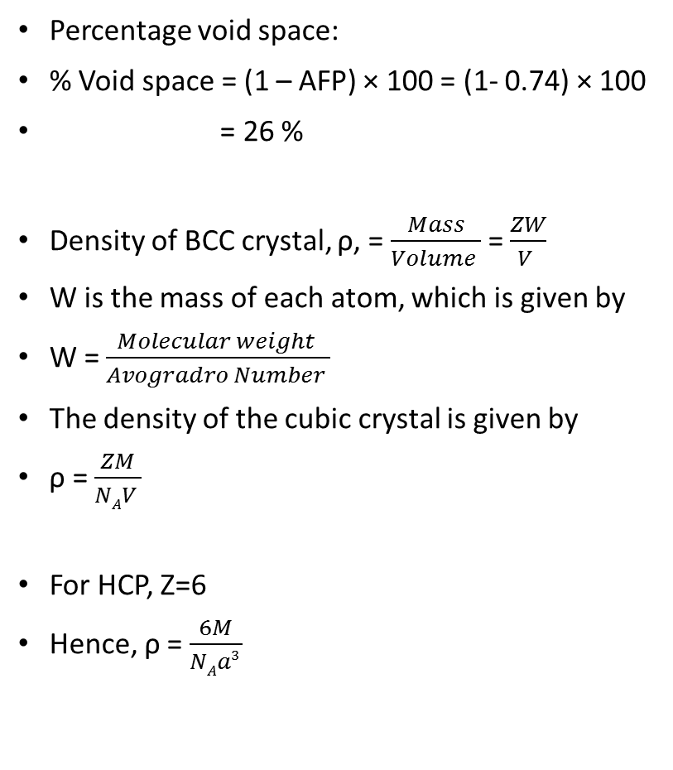
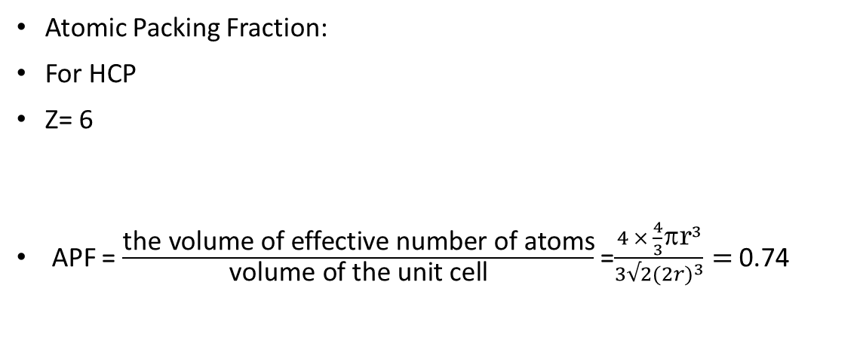
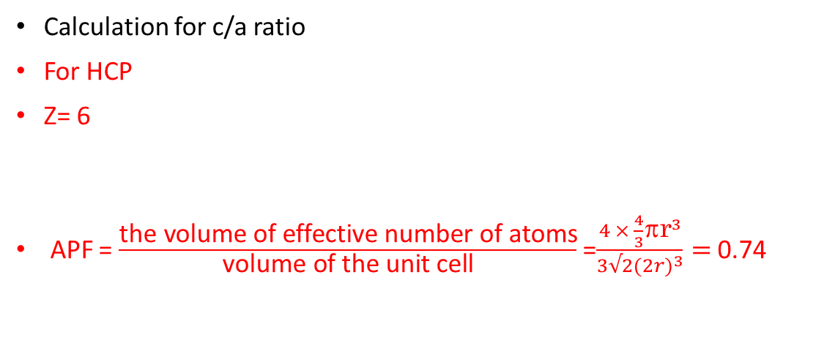
Atomic Packing Fraction:
For HCP
Z= 6
APF = $\frac{\text{the} \text{volume} \text{of} \text{effective} \text{number} \text{of} \text{atoms}}{\text{volume} \text{of} \text{the} \text{unit} \text{cell}}$ =$\frac{{4 × \frac{4}{3}\text{}\text{r}}^{3}}{3√2(2{r)}^{3}}=$0.74
Percentage void space:
% Void space = (1 – AFP) × 100 = (1- 0.74) × 100
= 26 %
Density of BCC crystal, ρ, = $\frac{Mass}{Volume }$ = $\frac{ZW}{V }$
W is the mass of each atom, which is given by
W = $\frac{Molecular weight }{Avogradro Number }$
The density of the cubic crystal is given by
ρ = $\frac{ZM}{NAV }$
For HCP, Z=6
Hence, ρ = $\frac{6M}{NAa3 }$
Calculation for c/a ratio
For HCP
Z= 6
APF = $\frac{\text{the} \text{volume} \text{of} \text{effective} \text{number} \text{of} \text{atoms}}{\text{volume} \text{of} \text{the} \text{unit} \text{cell}}$ =$\frac{{4 × \frac{4}{3}\text{}\text{r}}^{3}}{3√2(2{r)}^{3}}=$0.74

Slide 23
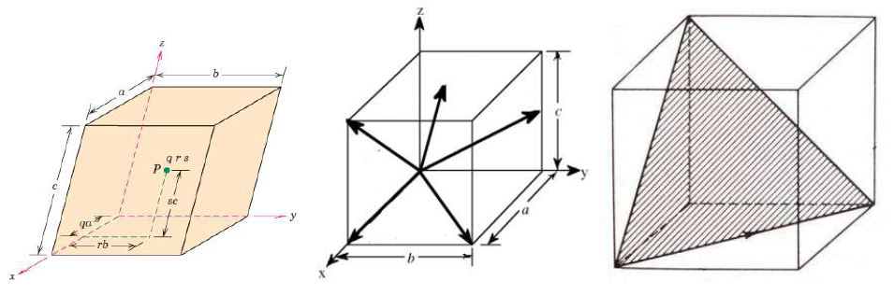
Indices of crystallographic direction
When dealing with crystalline materials, it often becomes necessary to specify a particular point within a unit cell, a crystallographic direction, or some crystallography
Three numbers or indices are used to designate point locations, directions, and planes.

Slide 24
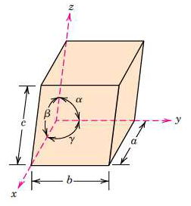
Lattice planes and Miller Indices
The basis for determining index values is the unit cell, with a right handed coordinate system consisting of three (x, y, and z) axes situated at one of the corners and coinciding with the unit cell edges, as shown in figure.
A unit cell with x, y, and z coordinate axes,
showing axial lengths (a, b, and c) and
interaxial angles (α, β, and γ).
Lattice parameters of crystal structure

Slide 25
Interplanar spacing in a cubic Lattice
On this basis there are seven different possible combinations of a, b, and c, and α, β, and γ, each of which represents a distinct crystal system.
These seven crystal systems are cubic, tetragonal, hexagonal, orthorhombic, rhombohedral, monoclinic, and triclinic.

Slide 26
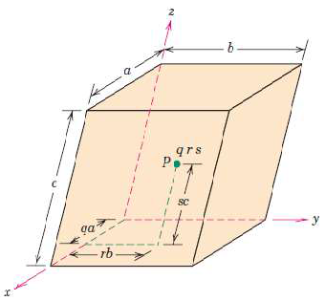
The position of any point located within a unit cell may be specified in terms of its coordinates as fractional multiples of the unit cell edge lengths (i.e., in terms of a, b, and c).
We specify the position of P in terms of the generalized coordinates q, p, and r, where q is some fractional length (qa) of a along the x axis, r is some fractional length (pb) of b along the y axis, and similarly for (rc) along Z axis. Thus, the position of P is designated using coordinates q r s with values that are less than or equal to unity.

Slide 27
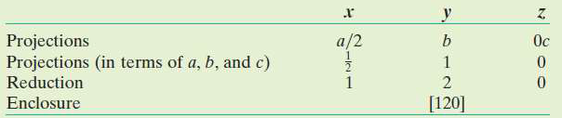
A crystallographic direction is defined as a line between two points or a vector. The following steps are utilized in the determination of the three directional indices:
A vector of convenient length is positioned such that it passes through the origin O of the coordinate system. Any vector may be translated throughout the crystal lattice without alteration, if parallelism is maintained.
The length of the vector projection on each of the three axes is determined; these are measured in terms of the unit cell dimensions a, b, and c.
These three numbers are multiplied or divided by a common factor to reduce them to the smallest integer values.
The three indices, not separated by commas, are enclosed in square brackets, thus: [u v w].

Slide 28
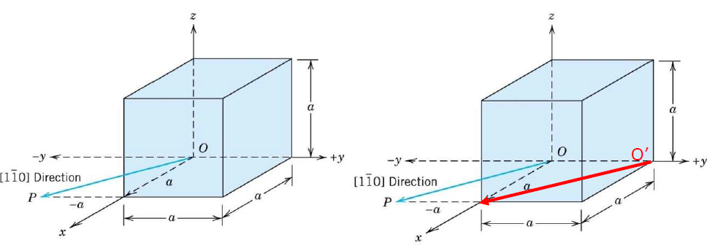
Draw a [110] direction within a cubic unit cell.
When one index is negative, it’s also possible to translate the origin O to the position O’, in order to have the direction within the unit cell.

Slide 29
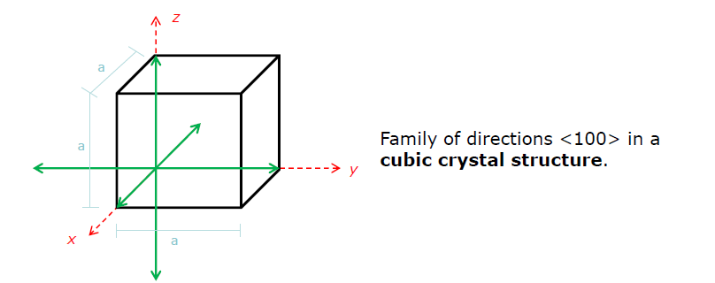
For some crystal structures, several nonparallel directions with different indices are actually equivalent; this means that the spacing of atoms along each direction is the same. For example, in cubic crystal, all the direction represented by the following indices are equivalent: [100], [100], [010], [010], [001], and [001]. As a convenience, equivalent directions are grouped together into a family of directions, which are enclosed in angle brackets, thus: <100>.

Slide 30
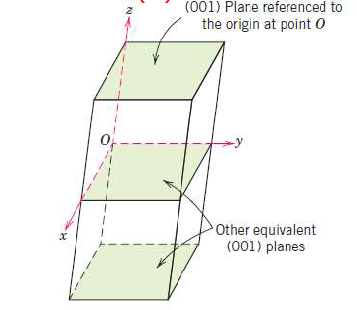
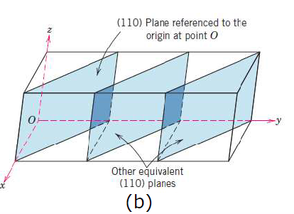
Crystallographic planes are specified by three Miller indices as (h k l). The procedure employed in determination of the h, k, and l index numbers is as follows:
If the plane passes through the selected origin O, either another parallel plane must be constructed within the unit cell by an appropriate translation (a), or a new origin O’ must be established at the corner of another unit cell (b).
(a)

Slide 31
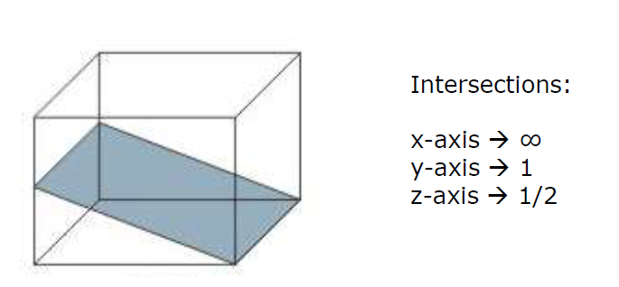
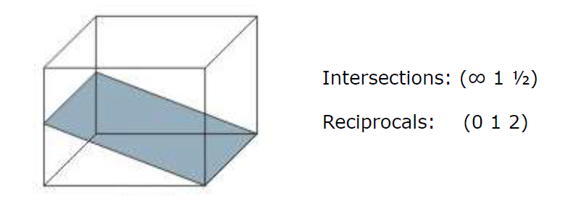
At this point the crystallographic plane either intersects or parallels each of the three axes; the length of the planar intercept for each axis is determined in terms of the lattice parameters a, b, and c. The reciprocals of these numbers are taken. A plane that parallels an axis may be considered to have an infinite intercept, and, therefore, a zero index. If necessary, these three numbers are changed to the set of smallest integers by multiplication or division by a common factor. Finally, the integer indices, not separated by commas, are enclosed within parentheses, thus: (h k l).

Slide 32
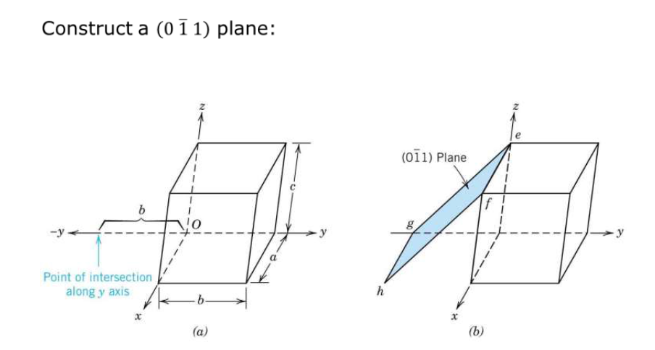

Slide 33
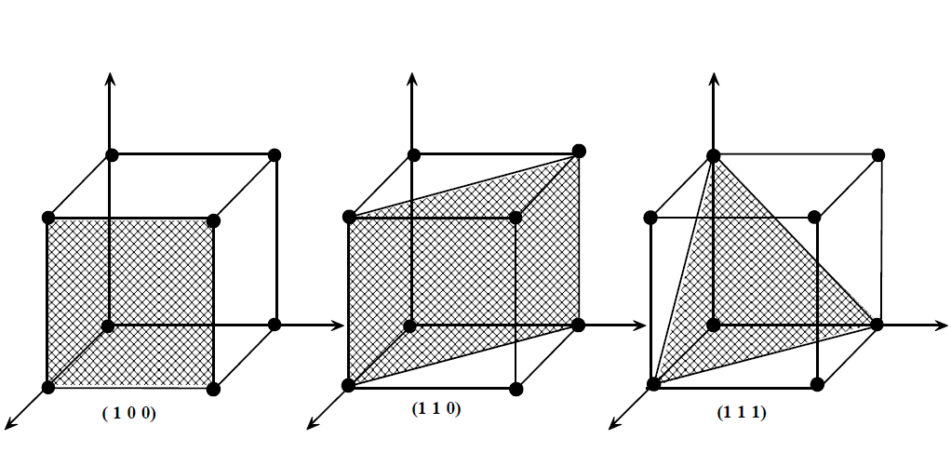

Slide 34
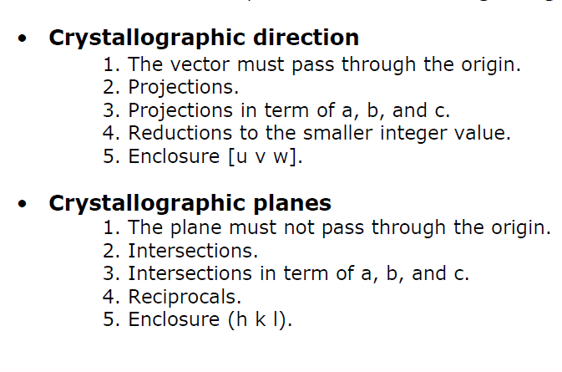
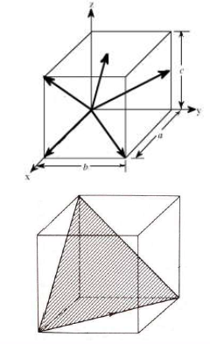

Slide 35
